Slide 1
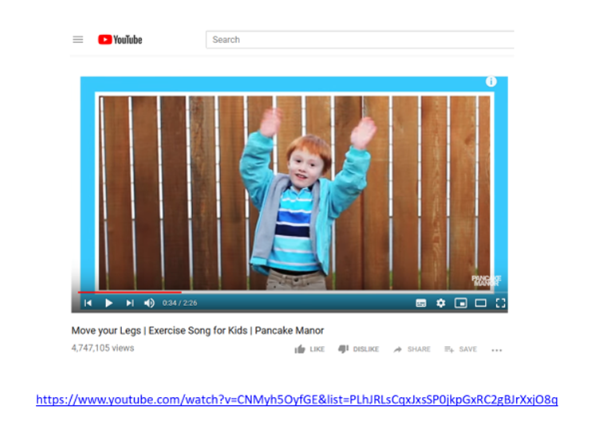
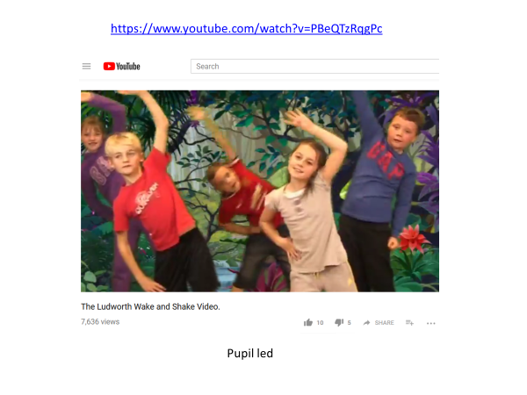
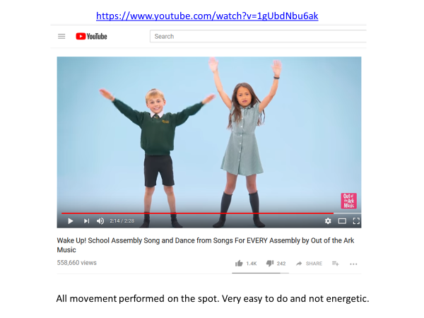
Lots of children have made their own exercise videos.
Can you make your own?
Ask your parents permission BEFORE doing this
Get an adult to help you film it
Your music needs to have a definite beat
Your actions need to be clear
Try doing each action at least 8 times
Repeating an action would help others to learn your routine

